Slide 1
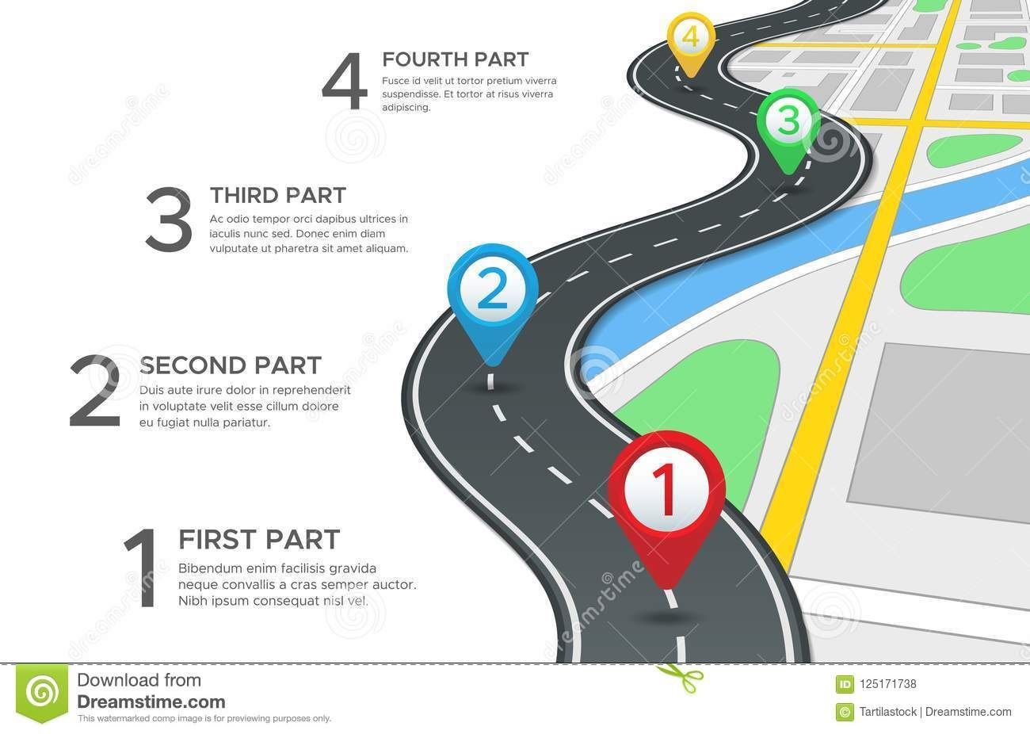
PATH NAVIGATION FOR A SMART CITY
GROUP(14)
TEAM MEMBERS :
Shafiya Begum AP21110010983
Navya Kotha AP21110010992
Renuka Kondapaneni AP21110011250
Bhavya Sri.V AP21110011007

Slide 2
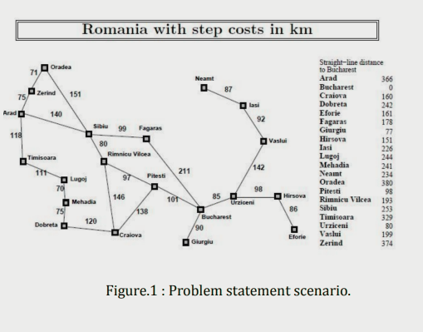

To create a path planning solution for robot R that moves from
location A to B in the shortest cost path using A* algorithm
PROBLEM
STATEMENT

Slide 3
INTRODUCTION
Path planning is used to find a path for a robot or vehicle to navigate from a start to a goal state .In this project we will be using A* algorithm.
Two Types of Path Planning:
1.Global(Informed)-static, well known, complete path, expensive complextiy.
2.Local(uninformed)-dynamic and unknown, more adaptable but
computationally challenging. 3.Essential Trade-Off Criteria:
Optimization
Completeness
Accuracy/Precision
d.Execution Time should be less
4.Heuristic Function: A function that estimates the distance between a node and the goal state, guiding the search towards the goal.

Slide 4
WHY A* ALGORITHM?
It is known for its efficiency and effectiveness in finding optimal paths in various domains.
Can handle complex environments with obstacles and constraints.
Adaptable to dynamic and changing conditions.
Applications:Robotics,Video games,Route Planning,Logistics,Artificial Intelligence.
Key Features:Admissibility,Heuristic Guidance,Efficiency,versatility.
METHODOLOGY
-> For this problem statement we are using the approach of A * Algorithms.
f(r) = g(n) + h(n.)
g(n) = cost so far to reach
n (n) = estimated cost to goal from n
f(n) = estimated total cost of path through n to goal A* search uses an admissible heuristic i.e., h(n) ≤h*(n) where h*(n) is the true cost from n.
CONSTRUCTION OF THE PROBLEM STATEMENT

Slide 5
ALGORITHM
1. Place the starting node s on open.
2. If open is empty, stop and return failure.
3. Remove from open the node n that has the smallest value of f*(n). If the node is a goal node,return success and stop.
4.Otherwise, Expand n, generating all of its successors n' and place n on closed. For every successor n', if n' is not already on open or closed attach a back-pointer to n, compute f*(n') and place it on open.
5. Each n' that is already on open or closed should be attached to back-pointers which reflect the lowest g* (n') path. If n' was on closed and its pointer was changed, remove it and place it on open.
6. Return to step 2.
By using the Methodology on the problem statement we get our path to reach from Arad to Bucharest as: Arad -> Sibiu -> Ramnicu Valcea -> Pitesti -> Bucharest

Slide 6
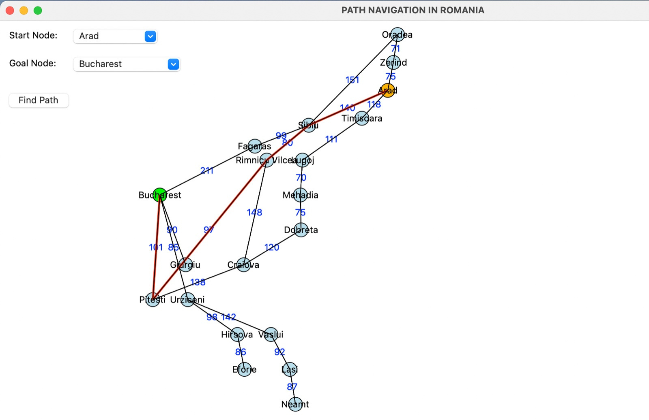
Output: Case 1: Path found by A* algorithm from Arad to Bucharest

Slide 7
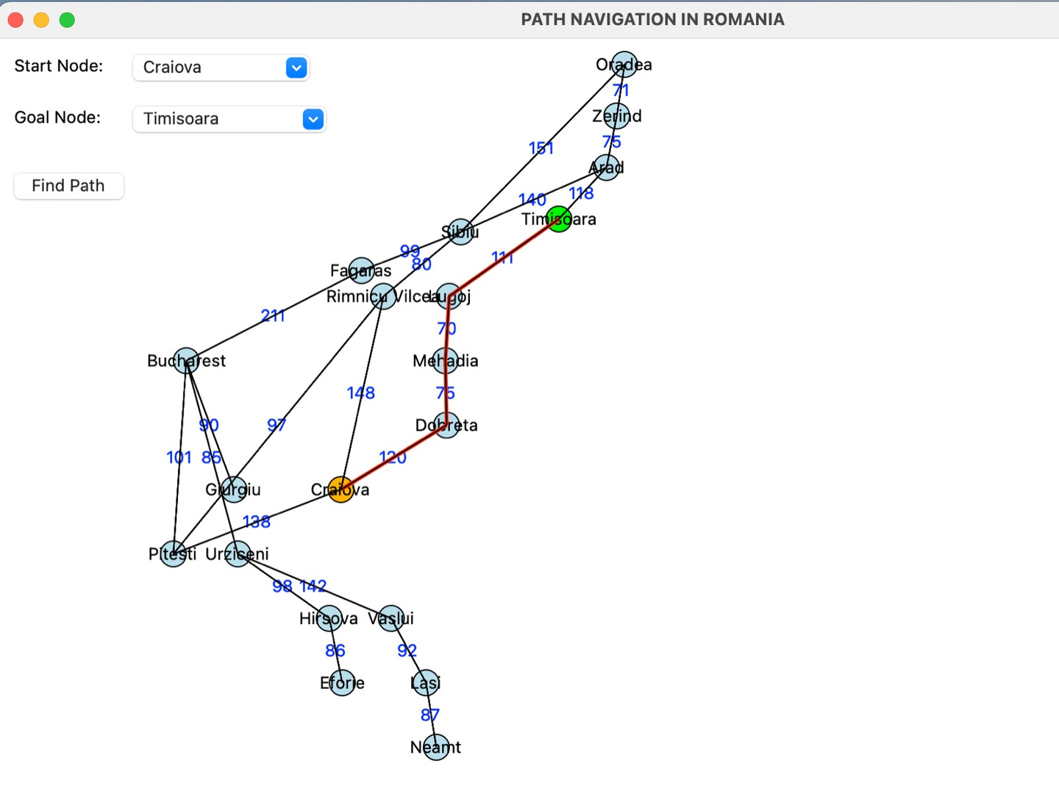
Output: Case 2: Path found by A* algorithm from Craiova to Timisoara

Slide 8

By doing this project, we can conclude that A* is a versatile and efficient algorithm that guarantees the discovery of the shortest path from a start node to a goal node, given certain conditions. It uses the heuristic function, accommodating factors like travel time, cost, or other relevant metrics.
Combining elements of Dijkstra's algorithm and greedy best-first search, A* employs a heuristic function to prioritize paths likely to lead to the goal quickly, resulting in faster convergence than uninformed search algorithms. Notably, A* demonstrates memory efficiency, making it well-suited for applications in memory-constrained environments. Widely employed in real-world scenarios .
A* stands out for its capability to efficiently find optimal paths, making it a popular choice where computational resources are limited.
CONCLUSION

Slide 9
THANK YOU
Dr. Tapas Kumar Mishra Sir

